Slide 1
Special Interest Group (SIG)-statistics
Fakhereh (Sarah) Alidoost
Amsterdam, 18/07/2019

Slide 2
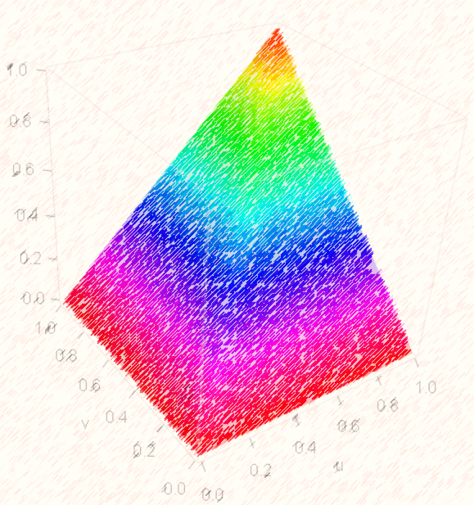
Copula /kɒpjʊlə/
The name comes from the Latin for "link" or "tie"

Slide 3
1) Introduction to copulas:
Notation (Cumulative distribution function / probability density function)
Dependence and joint distribution
Distribution family
Estimation vs. prediction
Multivariate joint distribution: The world of vines
2) Application of copulas:
Estimation vs. prediction
Use-case
Challenges (theoretical, technical)
Domains and communities

Slide 4
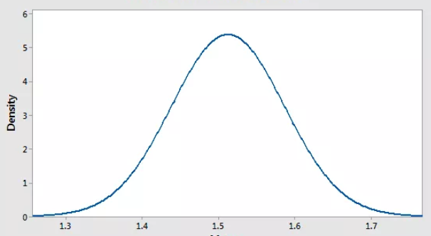
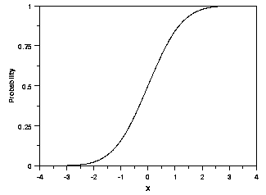
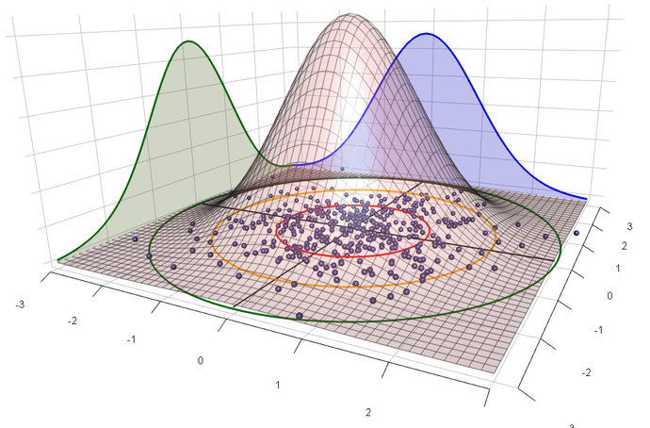
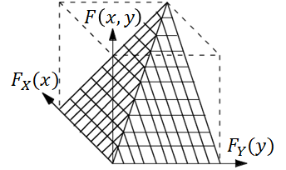
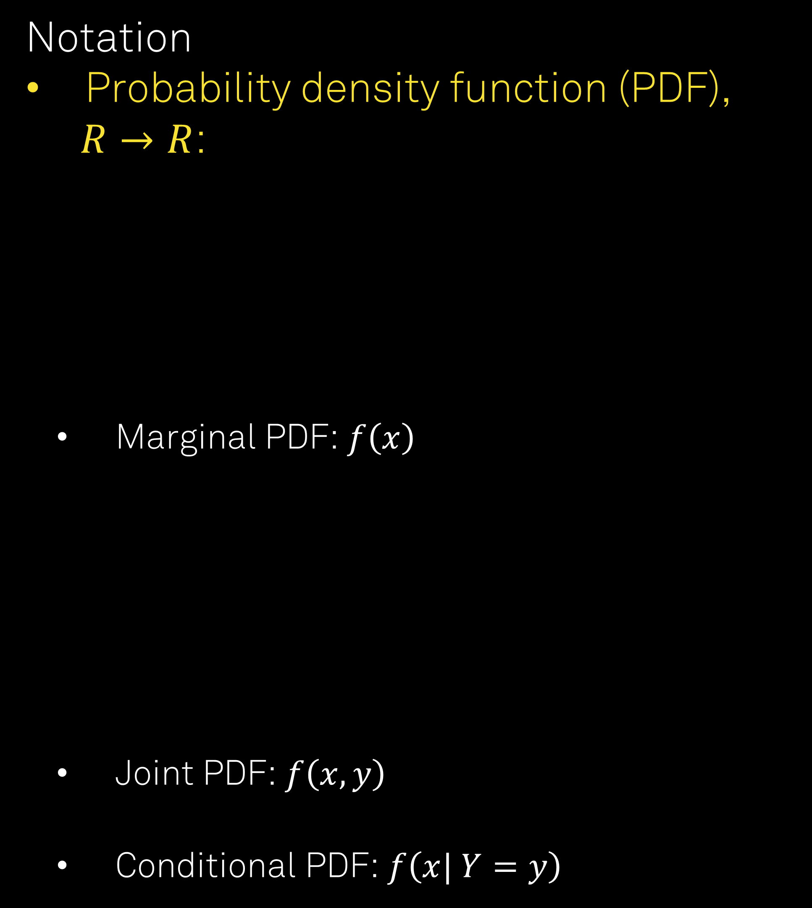
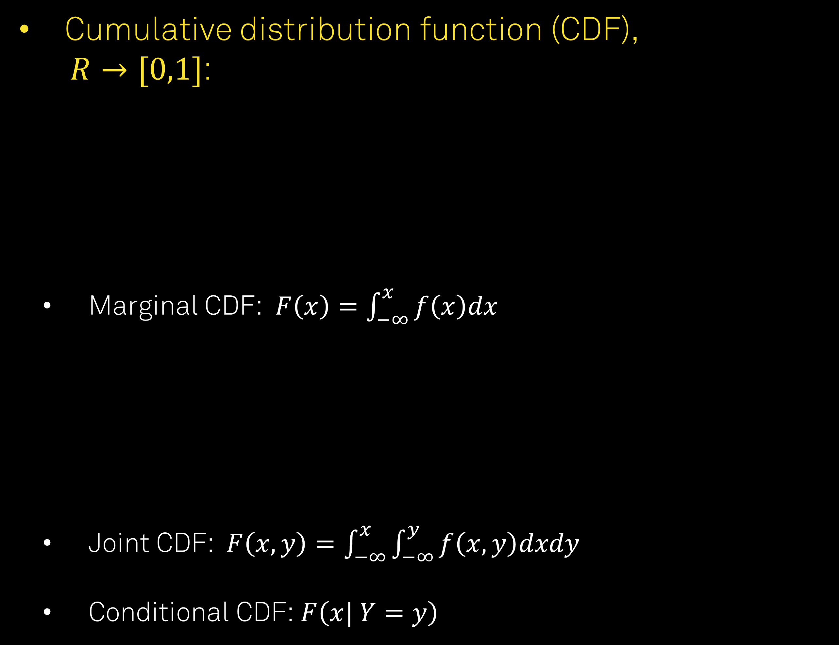
Notation
Probability density function (PDF),
$R→R$:
Marginal PDF: $f\left(x\right)$
Joint PDF: $f\left(x, y\right)$
Conditional PDF: $f\left(x| Y=y\right)$
Cumulative distribution function (CDF),
$R→[0,1]$:
Marginal CDF:$F\left(x\right)=\int_{−∞}^{x}{f\left(x\right)dx}$
Joint CDF: $F\left(x, y\right)=\int_{−∞}^{x}{\int_{−∞}^{y}{f\left(x, y\right)dxdy}}$
Conditional CDF: $F\left(x| Y=y\right)$

Slide 5
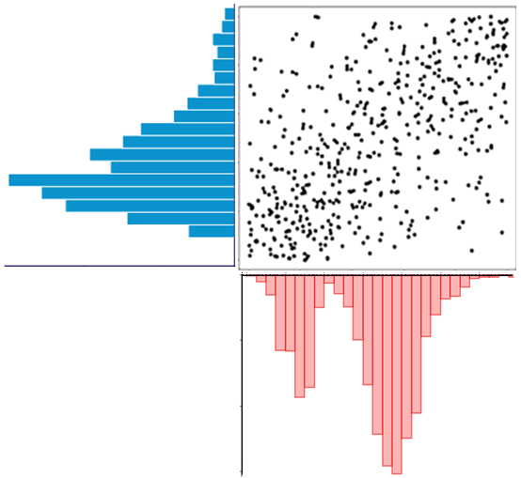
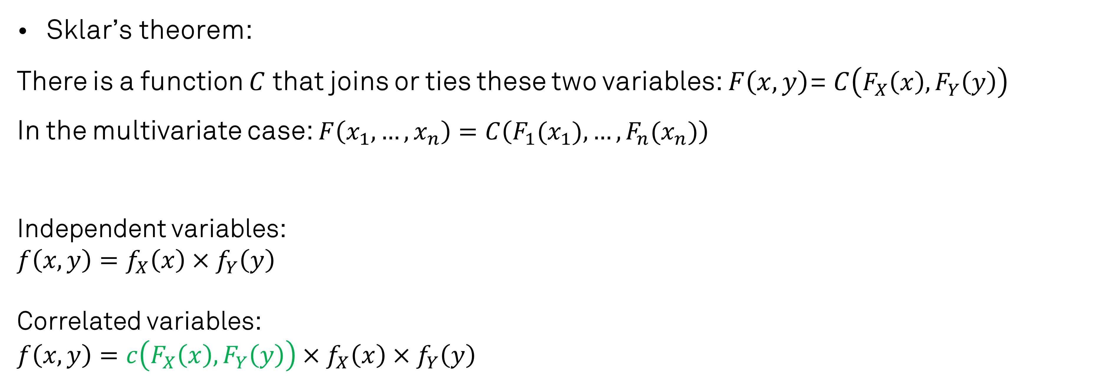
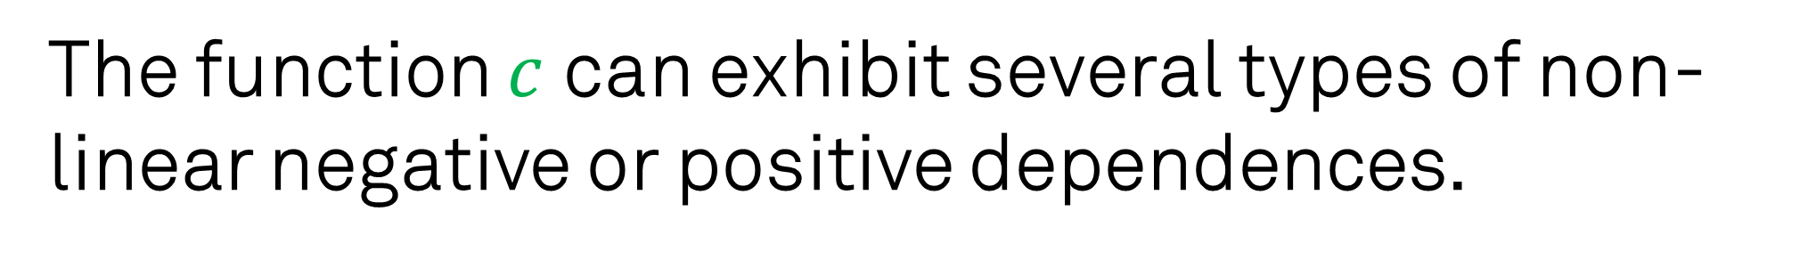
Dependence and joint distribution
Sklar’s theorem:
There is a function $C$ that joins or ties these two variables: $F\left(x,y\right)$= $C\left(F_{X}\left(x\right), F_{Y}\left(y\right)\right)$
In the multivariate case: $F\left(x_{1},…,x_{n}\right)=C\left(F_{1}(x_{1}),…,{F_{n}(x}_{n})\right)$
Independent variables:
$$f\left(x, y\right)=f_{X}\left(x\right)×f_{Y}\left(y\right)$$
Correlated variables:
$$f\left(x, y\right)=c\left(F_{X}\left(x\right),F_{Y}\left(y\right)\right)×f_{X}\left(x\right)×f_{Y}\left(y\right)$$
The function $c$ can exhibit several types of non-linear negative or positive dependences.

Slide 6
Distribution family
What family does a copula belong to?
Copulas can be characterized using any distribution family that can be different from the marginal family of the involved variables.
1 = Gaussian copula 2 = Student t copula (t-copula) 3 = Clayton copula 4 = Gumbel copula 5 = Frank copula 6 = Joe copula 7 = BB1 copula 8 = BB6 copula 9 = BB7 copula 10 = BB8 copula
13 = rotated Clayton copula (180 degrees; “survival Clayton”) 14 = rotated Gumbel copula (180 degrees; “survival Gumbel”) 16 = rotated Joe copula (180 degrees; “survival Joe”) 17 = rotated BB1 copula (180 degrees; “survival BB1”) 18 = rotated BB6 copula (180 degrees; “survival BB6”) 19 = rotated BB7 copula (180 degrees; “survival BB7”) 20 = rotated BB8 copula (180 degrees; “survival BB8”) 23 = rotated Clayton copula (90 degrees) 24 = rotated Gumbel copula (90 degrees) 26 = rotated Joe copula (90 degrees)
27 = rotated BB1 copula (90 degrees) 28 = rotated BB6 copula (90 degrees) 29 = rotated BB7 copula (90 degrees) 30 = rotated BB8 copula (90 degrees) 33 = rotated Clayton copula (270 degrees) 34 = rotated Gumbel copula (270 degrees) 36 = rotated Joe copula (270 degrees) 37 = rotated BB1 copula (270 degrees) 38 = rotated BB6 copula (270 degrees) 39 = rotated BB7 copula (270 degrees)
40 = rotated BB8 copula (270 degrees)
104 = Tawn type 1 copula 114 = rotated Tawn type 1 copula (180 degrees) 124 = rotated Tawn type 1 copula (90 degrees) 134 = rotated Tawn type 1 copula (270 degrees) 204 = Tawn type 2 copula 214 = rotated Tawn type 2 copula (180 degrees) 224 = rotated Tawn type 2 copula (90 degrees) 234 = rotated Tawn type 2 copula (270 degrees)

Slide 7
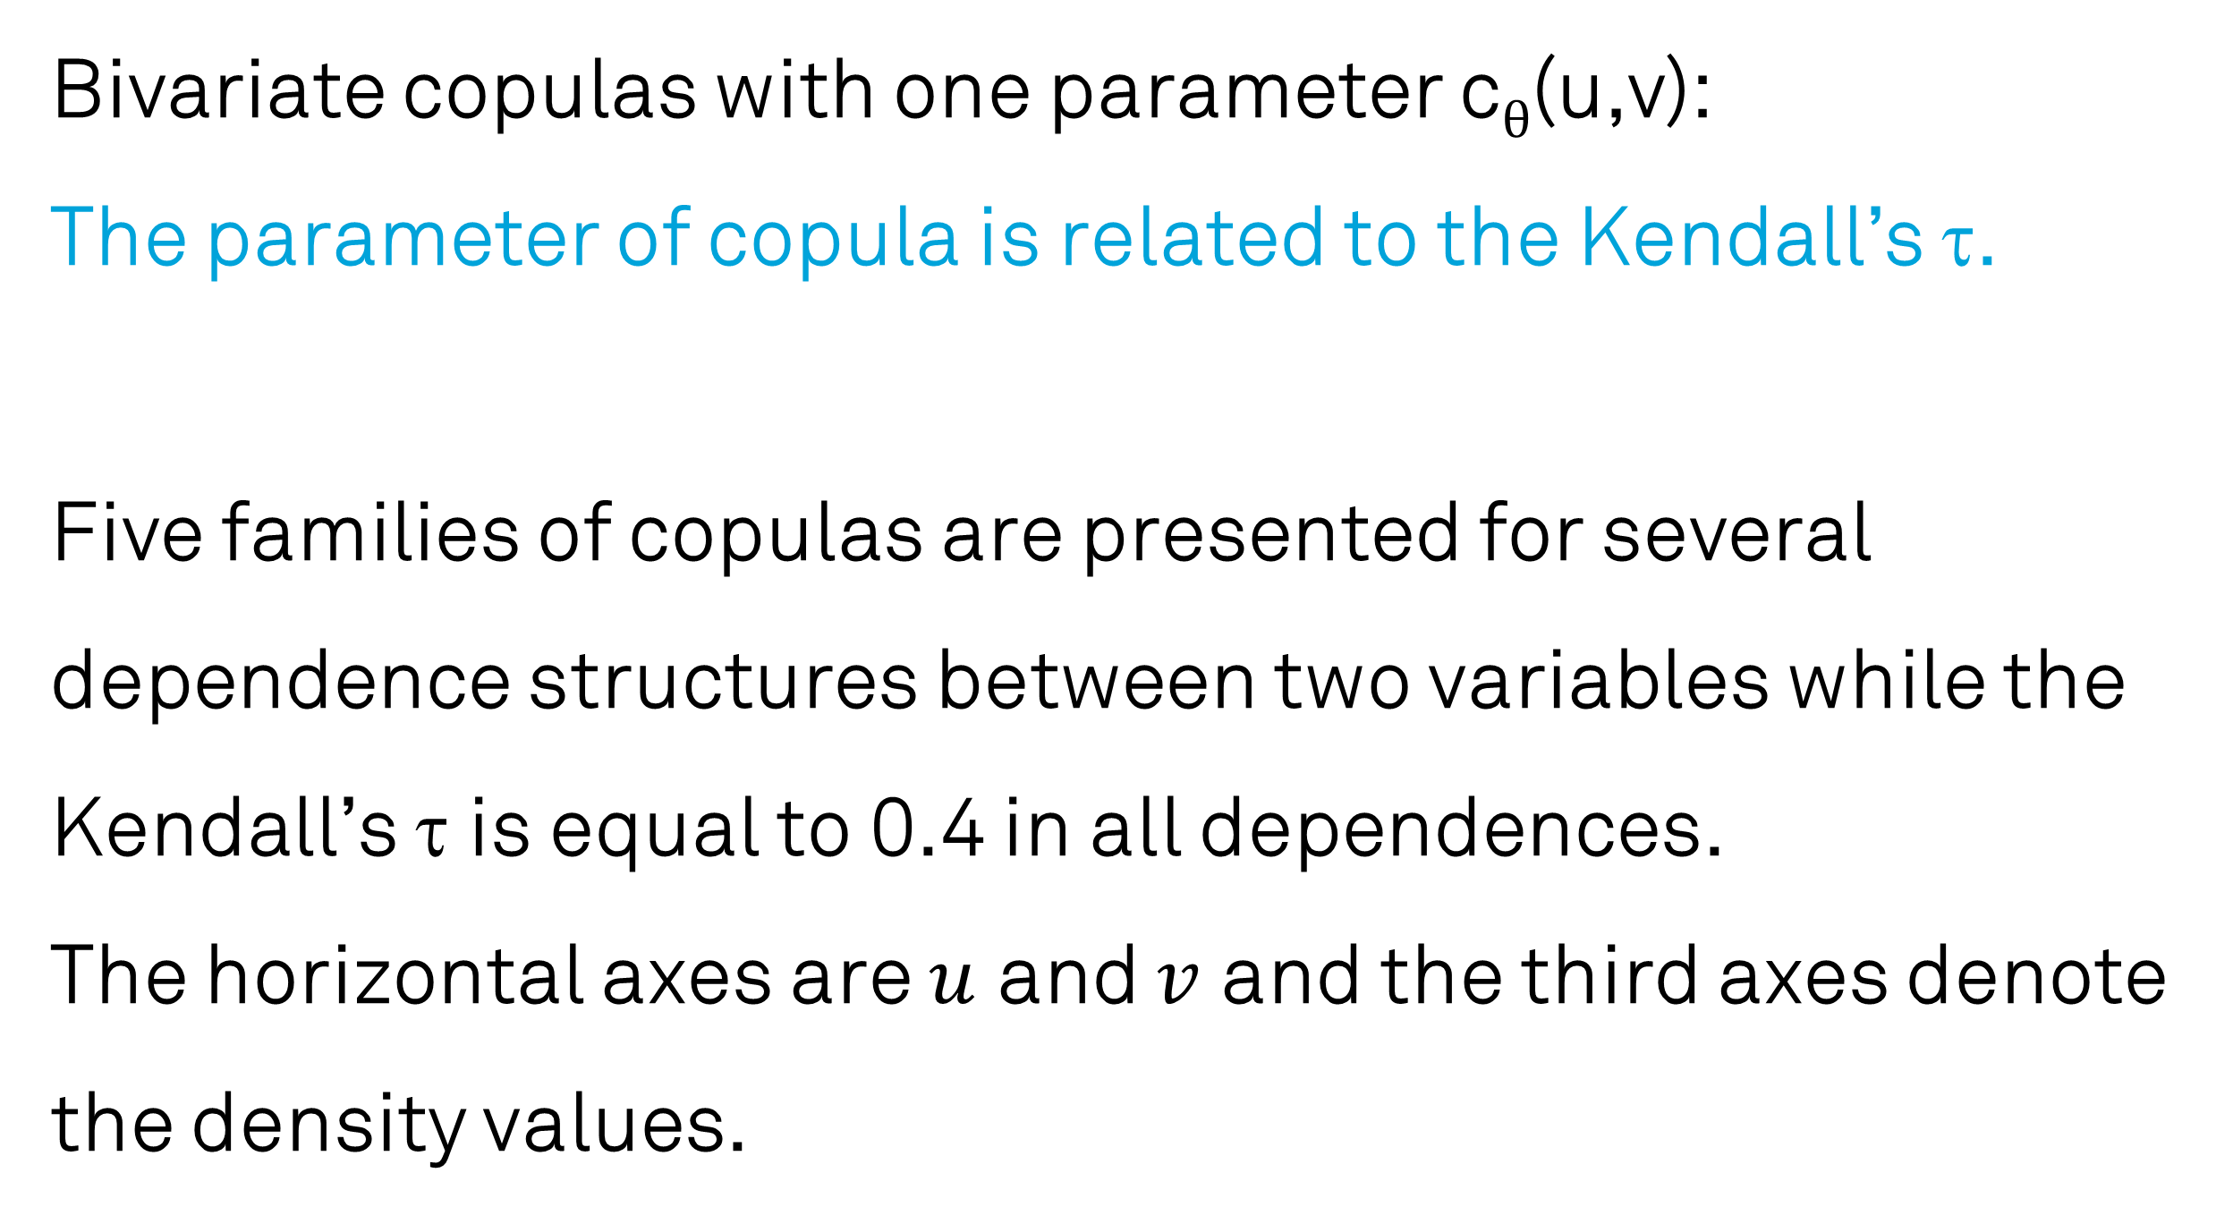
Distribution family
Bivariate copulas with one parameter c_{θ}(u,v):
The parameter of copula is related to the Kendall’s τ.
Five families of copulas are presented for several dependence structures between two variables while the Kendall’s τ is equal to 0.4 in all dependences.
The horizontal axes are $u$ and $v$ and the third axes denote the density values.

Slide 8
Distribution family
The densities of Frank copula for several values of the Kendall’s τ.

Slide 9
Estimation vs. prediction
Copula estimation (bivariate case):
We apply maximum likelihood to estimate the parameter for each family using starting values obtained by Kendall’s τ, being a measure for association between variables (Nelsen, 2006).
The most suitable family is selected according to Akaike’s Information Criteria (AIC) (Akaike, 1974).

Slide 10
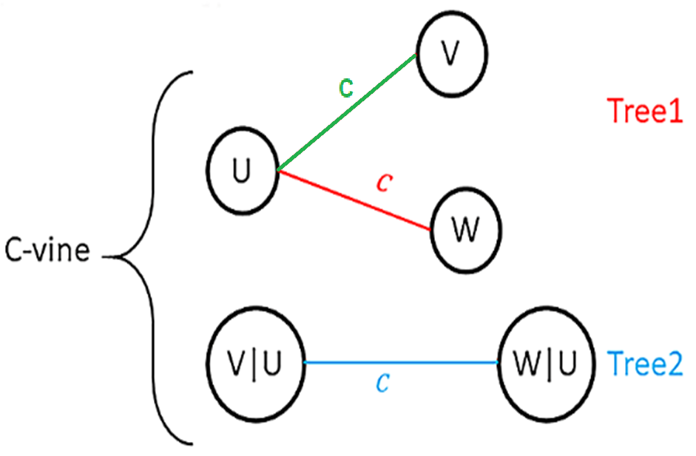
Multivariate joint distribution: The world of vines
Let’s consider three random variables X, Y and Z with a copula C(U,V, W), where X is the target variable. The configuration of the structure is based upon c-vine, Sklar’s theorem and the general decomposition rule of
f(x, y, z)=f(z)×f(y|z)×f(x|y,z).
In this example, the copula density c(U,V, W) is first decomposed into bivariate copulas as: c(U,W), c(U,V) and c(C(W|U),C(V|U)). Then, the copula density is the product of all bivariate copula densities in the structure:
c(u,v, w)=c(u,w)×c(u,v)× c(C(W|U),C(V|U)).
It follows that the dependence structure between those n=3 variables is described by a combination of n different families and in total n×(n-1)/2 parameters.

Slide 11
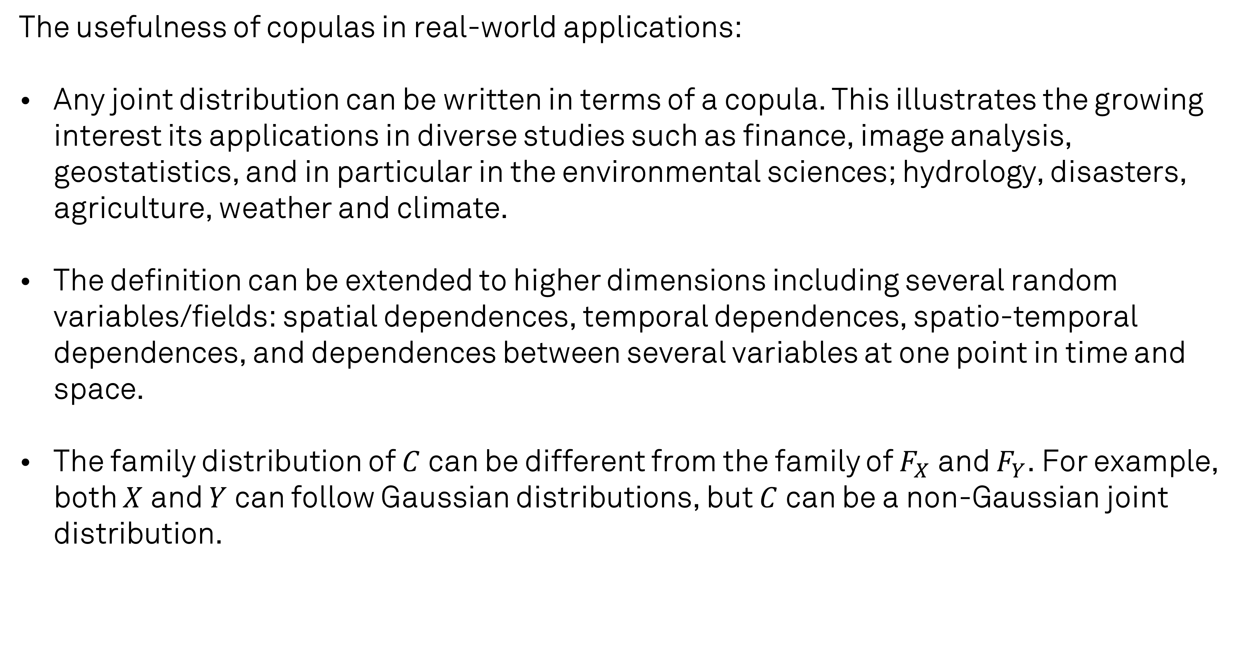
Multivariate joint distribution
The usefulness of copulas in real-world applications:
Any joint distribution can be written in terms of a copula. This illustrates the growing interest its applications in diverse studies such as finance, image analysis, geostatistics, and in particular in the environmental sciences; hydrology, disasters, agriculture, weather and climate.
The definition can be extended to higher dimensions including several random variables/fields: spatial dependences, temporal dependences, spatio-temporal dependences, and dependences between several variables at one point in time and space.
The family distribution of $C$ can be different from the family of $F_{X}$ and $F_{Y}$. For example, both $X$ and $Y$ can follow Gaussian distributions, but $C$ can be a non-Gaussian joint distribution.

Slide 12
A copula is a cumulative joint distribution function describing complex dependence structures.

Slide 13
1) Introduction to copulas:
Notation (Cumulative distribution function / probability density function)
Dependence and joint distribution
Distribution family
Estimation vs. prediction
Multivariate joint distribution: The world of vines
2) Application of copulas:
Estimation vs. prediction
Use-case
Challenges (theoretical, technical)
Domains and communities

Slide 14
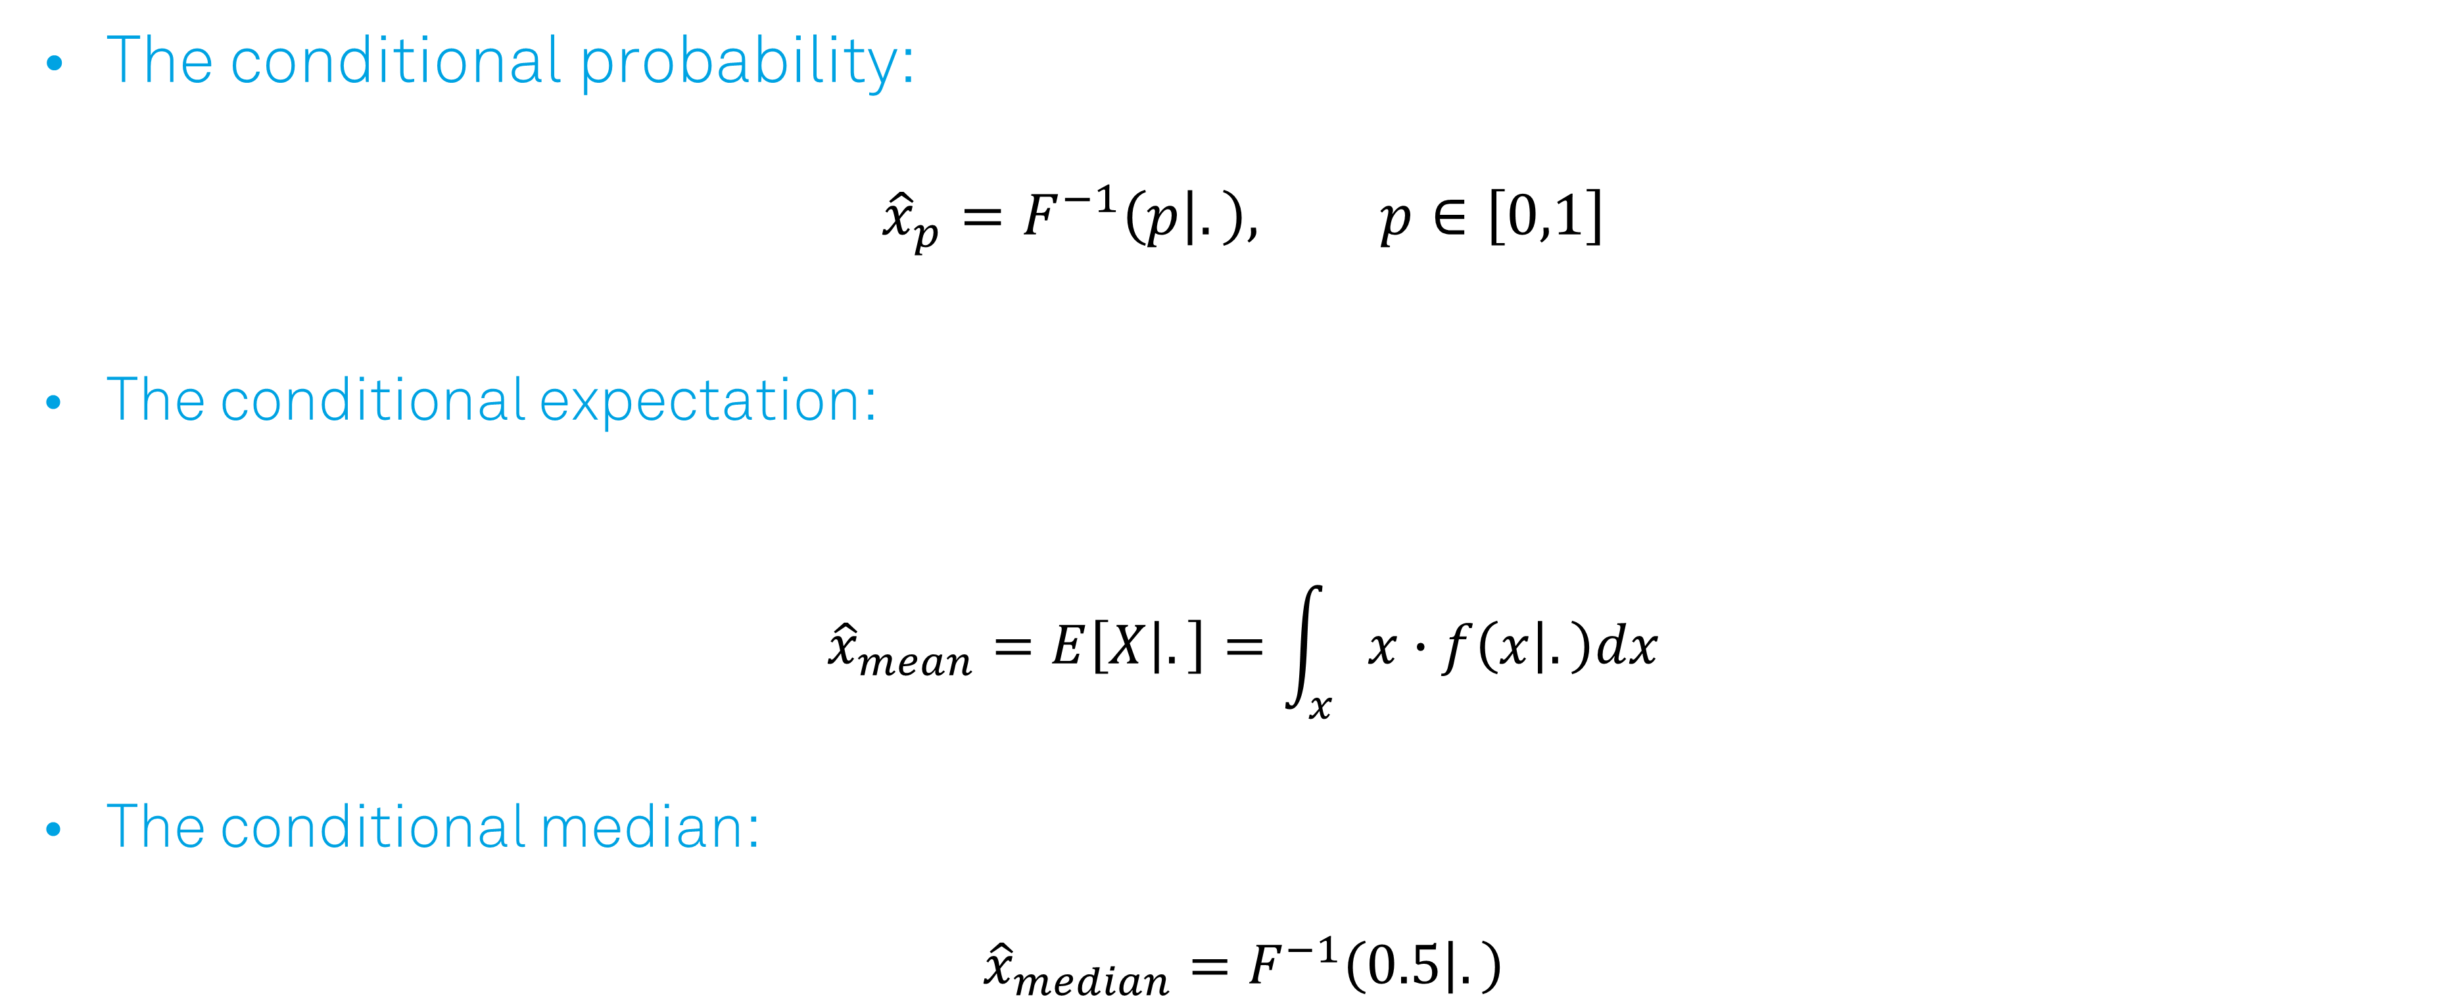
Estimation vs. prediction
The conditional probability:
$${\hat{x}}_{p}=F^{−1}\left(p | .\right), p∈\left[0,1\right]$$
The conditional expectation:
$${\hat{x}}_{mean}=E\left[X | .\right]=\int_{x}{x∙f\left(x | .\right)dx}$$
The conditional median:
$${\hat{x}}_{median}=F^{−1}\left(0.5 | .\right)$$

Slide 15
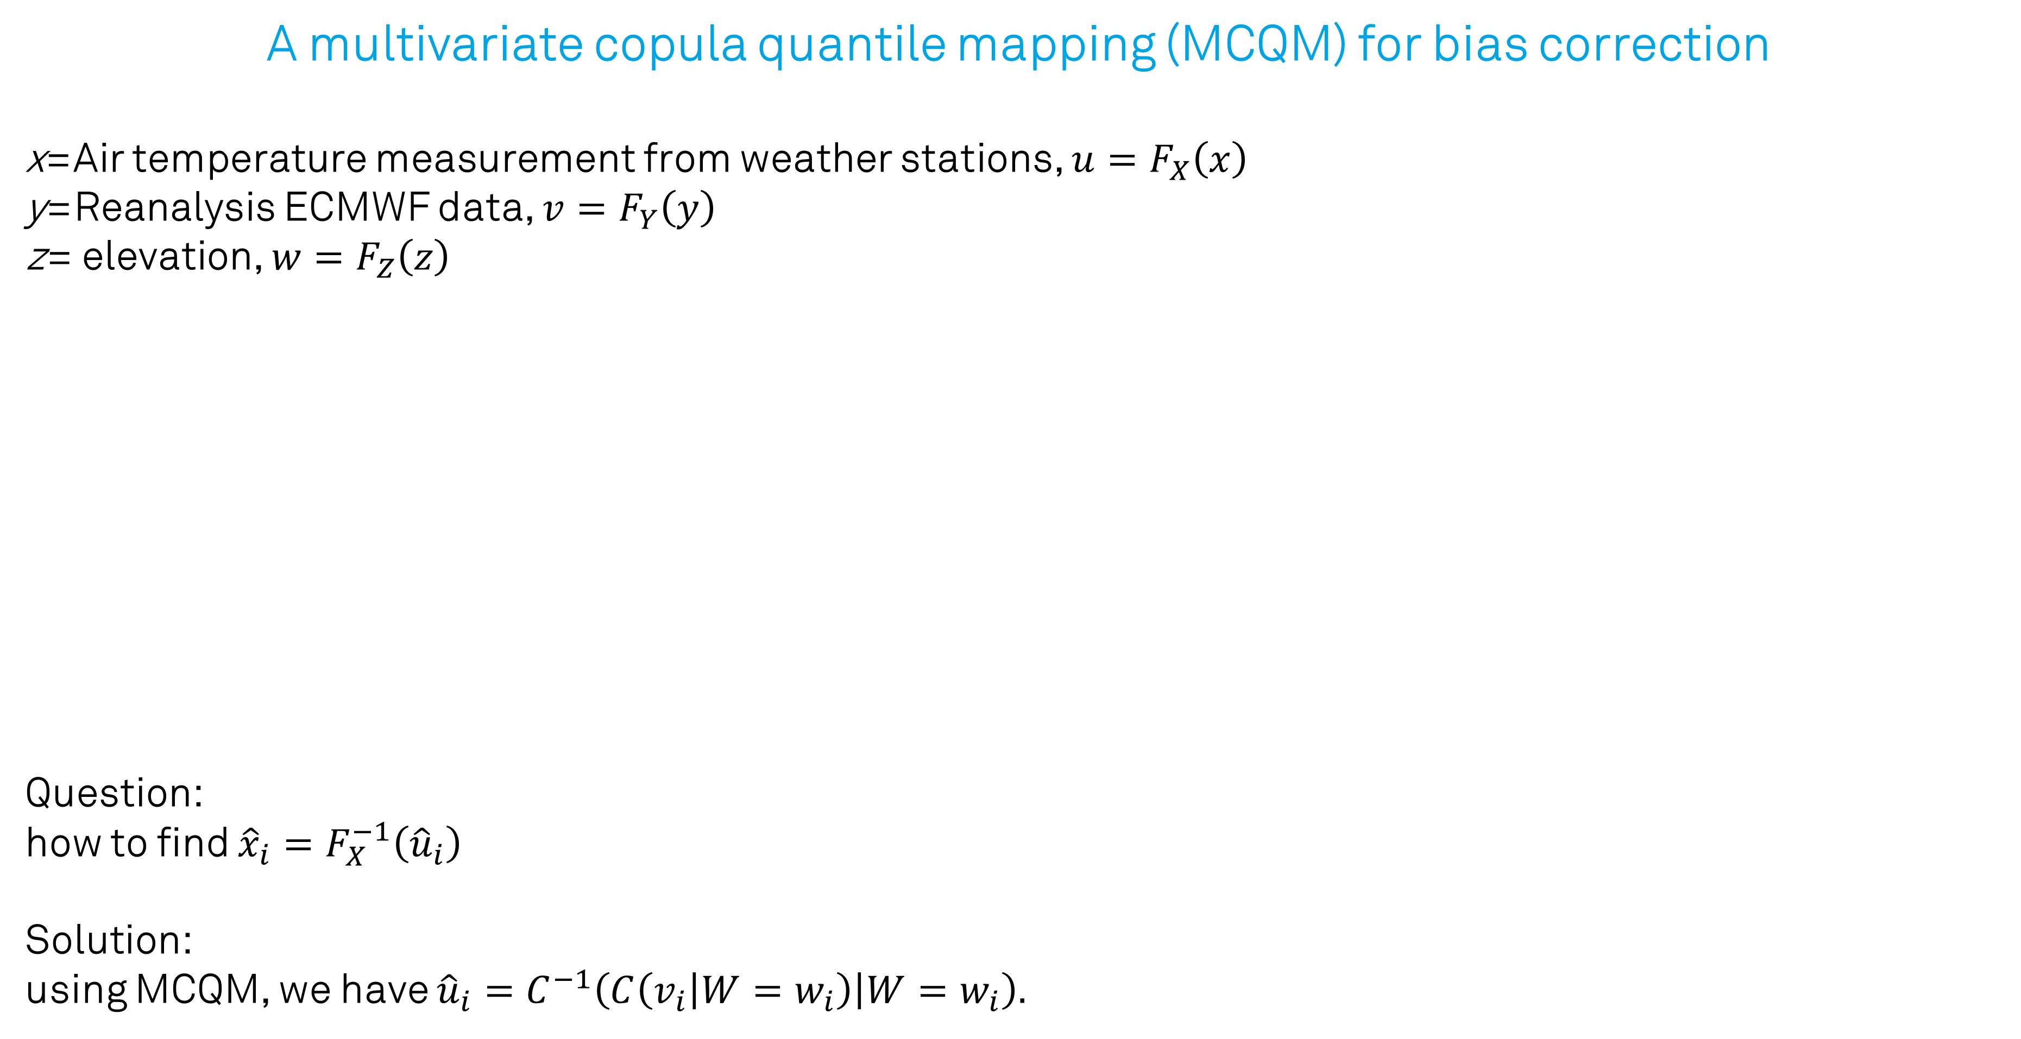
Use-case
A multivariate copula quantile mapping (MCQM) for bias correction
x=Air temperature measurement from weather stations, ${u=F}_{X}\left(x\right)$
y=Reanalysis ECMWF data, $v=F_{Y}\left(y\right)$
z= elevation, $w=F_{Z}\left(z\right)$
Question:
how to find ${\hat{x}}_{i}=F_{X}^{−1}\left({\hat{u}}_{i}\right)$
Solution:
using MCQM, we have ${\hat{u}}_{i}=C^{−1}\left(C\left(v_{i} | W=w_{i}\right) | W=w_{i}\right).$

Slide 16

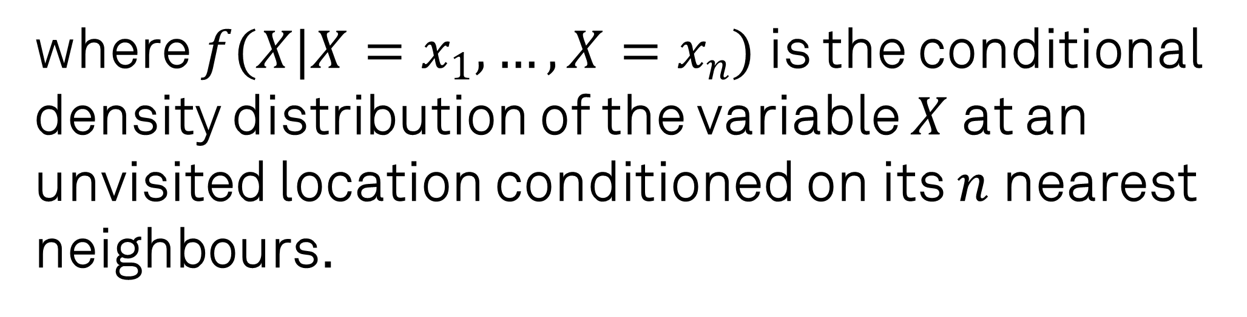
Use-case
A multivariate copula-based interpolator for downscaling
$$Question:$$
How to find ${\hat{x}}_{0}=E\left[X | X=x_{1},…,X=x_{n}\right]=\int_{x}{x∙f\left(X | X=x_{1},…,X=x_{n}\right)dx}$
Solution
Copula based interpolator: ${\hat{x}}_{0}=\int_{0}^{1}{F^{−1}\left(u\right)∙c\left(U | U=u_{1},…,U=u_{n}\right)du}$
where $f(X|X=x_{1},…,X=x_{n})$ is the conditional density distribution of the variable $X$ at an unvisited location conditioned on its $n$ nearest neighbours.

Slide 17
Use-cases
Methods in geo statistic:
Integration
Spatio-temporal modeling
Interpolation
Bias correction
Downscaling
Data assimilation
Application in geo statistic:
Groundwater quality parameters
Predicting flood
Trajectories and Sensor Observation Service
Daily mean air temperature
Evaluating the effects of climate extremes on crop variables

Slide 18
Challenges (theoretical, technical)
Numerical evaluations concern the implementations of some mathematical/statistical operations for copula families, such as partial derivatives and inverse transformations.
A d-dimensional joint probability, d > 2, is obtained using the numerical evaluations and simulations that are associated with uncertainty.
For a deterministic approach, the main theories of copulas that are based upon probabilistic explanations need to be extended.

Slide 19
Domains and communities
Kjersti Aas
The Norwegian Computing Centre
Eike Brechmann
Center for Mathematical Sciences, Technische Universität München
Claudia Czado
Center for Mathematical Sciences, Technische Universität München
Benedikt Gräler
52°North Initiative for Geospatial Open Source Software GmbH, Muenster, Germany
Claus P. Haslauer
University of Tuebingen, EKU Tübingen , Department of Geosciences

Slide 20
References
Alidoost, F., (2019), Copulas for integrating weather and land information in space and time (Doctoral ). University of Twente.
Gräler, B., (2014), Developing spatio-temporal copulas (Doctoral ). Westfälische Wilhelms-Universität Münster.
Aas, K., et al. (2009). Pair-copula constructions of multiple dependence. Insurance: Mathematics and Economics, 44(2), 182–198.
Nelsen, R. B. (2006), An Introduction to Copulas. United States of America: Springer.
Genest, C. and Favre, A.C. (2007). Everything You Always Wanted to Know about Copula Modeling but Were Afraid to Ask. Journal of Hydrologic Engineering, 12(4), 347-368.
https://github.com/cran/copula
https://github.com/topics/copula

Slide 21
Let’s stay in touch
f.alidoost@esciencecenter.nl
https://www.esciencecenter.nl/profile/sarah
https://nl.linkedin.com/in/fakhereh-sarah-alidoost-11a24a89

